Slide 1

IBM Professional certificate: Deep Learning & Reinforcement Learning
Ibrahim Mohamed
Oct 2022

Slide 2
Main objective
This analysis' primary goal is to cluster tumours into benign or malignant
So clustering is the main target analysis for our deep learning
Show the correlation between the features & the most features with impact.
Validate the clusters with binary classification.

Slide 3
ABOUT BRAIN TUMORS
One of the more aggressive disorders affecting both children and adults is the brain tumour. 85 to 90 percent of all primary Central Nervous System (CNS) malignancies are brain tumours. About 11,700 patients are given a brain tumour diagnosis each year. For those who have a malignant brain or CNS tumour, the 5-year survival rate is roughly 34% for males and 36% for women. Benign, malignant, pituitary, and other types of brain tumours are all categorised. To extend patient lives, appropriate care, careful planning, and precise diagnostics must be used. Magnetic Resonance Imaging is the most effective method for finding brain cancers (MRI)

Slide 4
ABOUT BRAIN TUMORS
When abnormal cells develop within the brain, a brain tumour results. Tumors can be classified as either cancerous (malignant) or benign. Cancerous tumours can be separated into primary tumours, which begin inside the brain, and secondary tumours, or brain metastasis tumours, which have spread from somewhere else. Depending on where section of the brain is affected, all types of brain tumours can cause a variety of symptoms. Headaches, seizures, eye issues, nausea, and mental disturbances are a few examples of these symptoms. Typically, a headache gets better in the morning and disappears with vomiting. Other signs may include trouble speaking, walking, or feeling things. Unconsciousness could happen as the illness worsens.

Slide 5
About the data
This dataset is Brain MRI scans used for brain tumor classification
The data consists of two classes, NO (bengin) = 0 or YES (maligint) = 1.
In this analysis we will explore the MRI Brain images dataset in more details to approach a robust deep learning model aims to help doctors over the world in brain tumors diagnosis.
The selected model should be robust enough to detect tumors in the brain since there is no room for many errors in this delicate field.

Slide 6
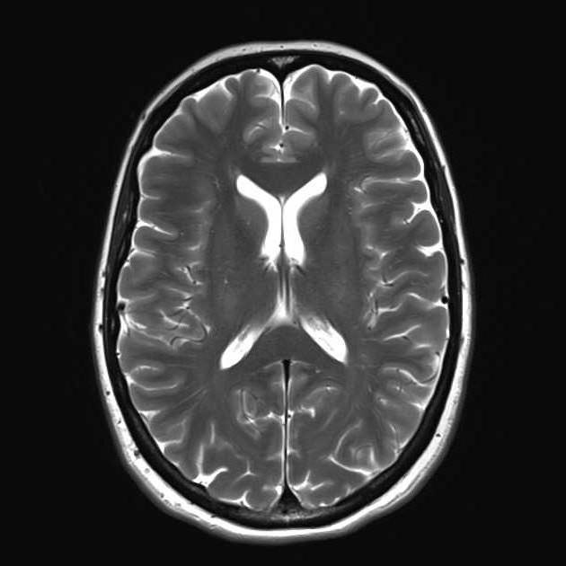
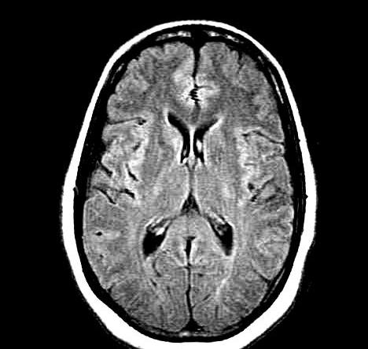
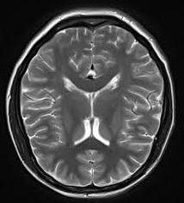
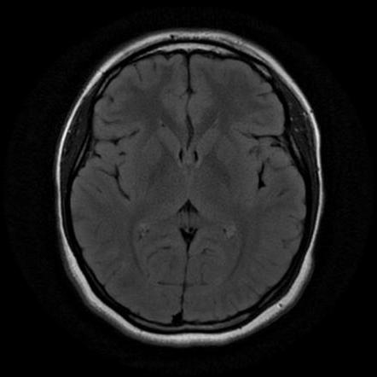
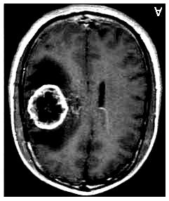
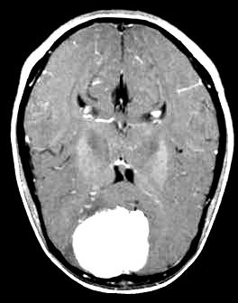
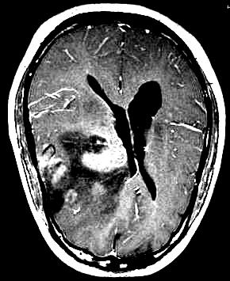
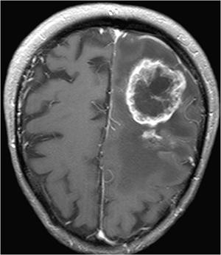
About the data
There are two folders,
- Folder 1 contains 1500 Brain MRI Scans where they are not tumorous
- Folder 2 contains 1500 Brain MRI Scans where they are tumorous
No Tumor
Tumor

Slide 7
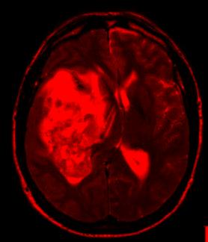
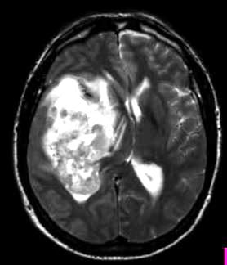
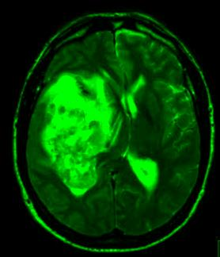
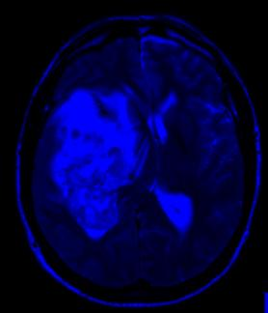
Exploratory Data analysis
- Identifying images types and dimension:
R – Channel
Images type : JPG
Dimensions : (width, height, 3)
Image sample: “y652.jpg”
(324, 278, 3)
324 pixels
G – Channel
278 pixels
B – Channel

Slide 8
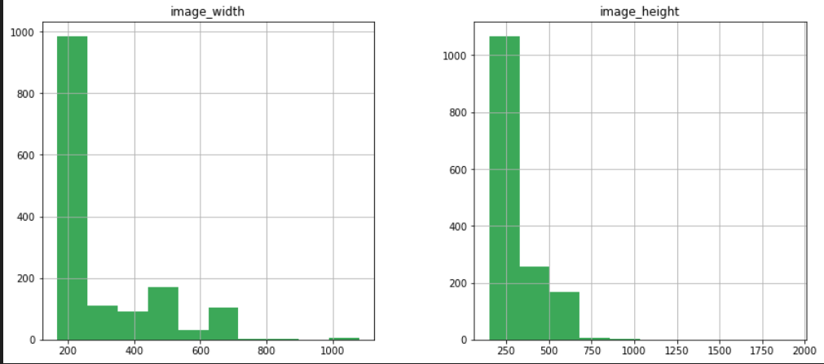
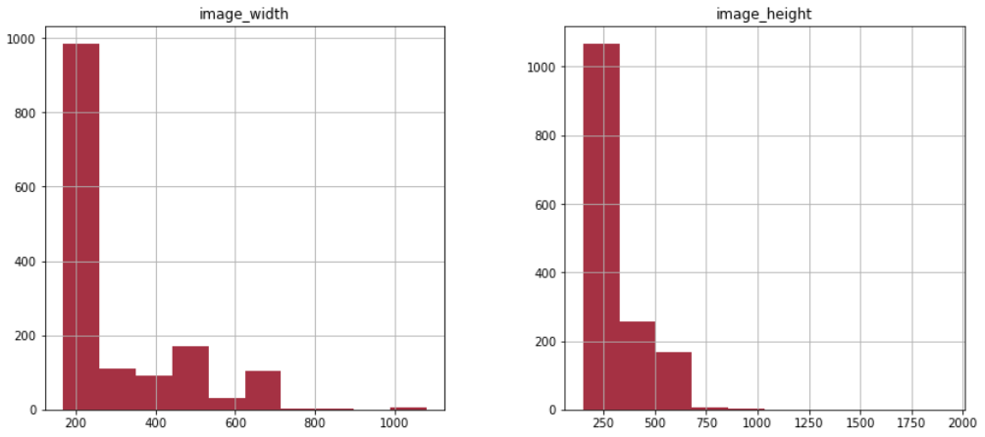
Exploratory Data analysis
Images Width & Height
Benign
Malignant

Slide 9
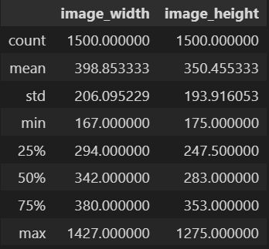
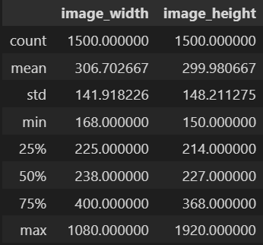
Exploratory Data analysis
Statistics :
Benign
Malignant

Slide 10
Feature engineering
Images Resizing
Due to the architecture of deep learning models, we must uniformly scale all the dimensions because we have photos of varying dimensions:
Input shape = 64 pixels
After reshaping every image, we store them in a NumPy array

Slide 11
Feature engineering
Train-Test Split
we have in total 3000 images from this point we are going to split these images into two sets 80% for training set and 20% testing set
So we have 2400 Images for training and 600 image for testing

Slide 12
Machine learning analysis
CNN Categorical Cross Entropy Based & SoftMax Function.
Fully Connected NN
+SoftMax
Conv + Relu
Pooling 2x2
Conv + Relu
Pooling 2x2
Conv + Relu
Pooling 2x2
Flatten
64x64x3
6x6x32
14x14x32
12x12x32
31x31x32
29x29x32
2304
62x62x32

Slide 13
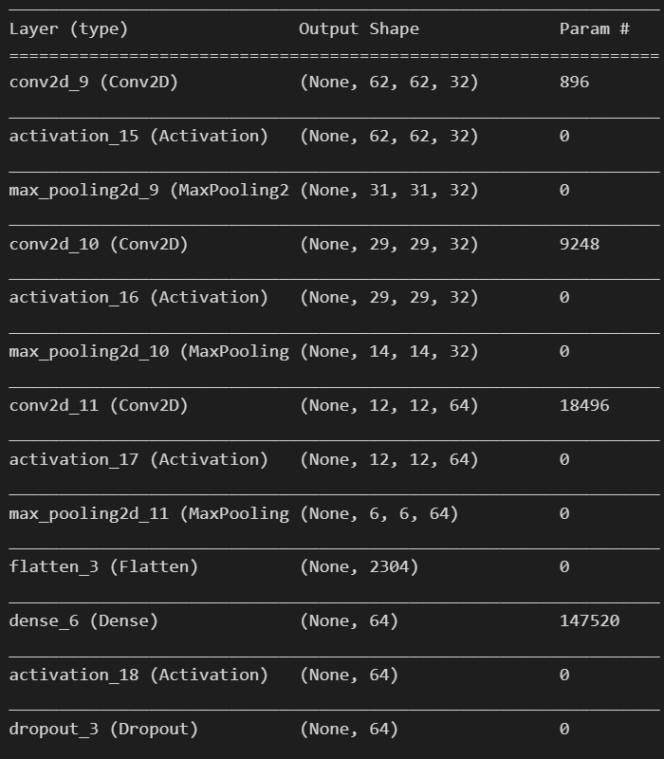
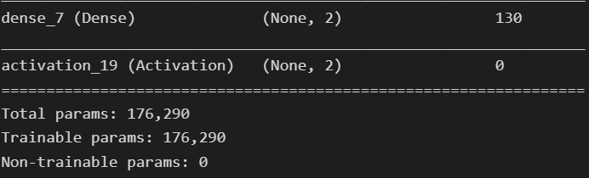
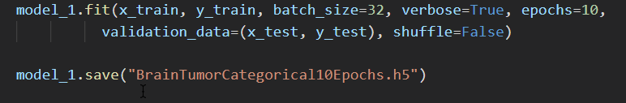
Machine learning analysis
CNN Categorical Cross Entropy Based & SoftMax Function.
Architecture & total number of parameters:
Total Prams: 176.290
Trainable Params: 176.290
Non-trainable: 0

Slide 14
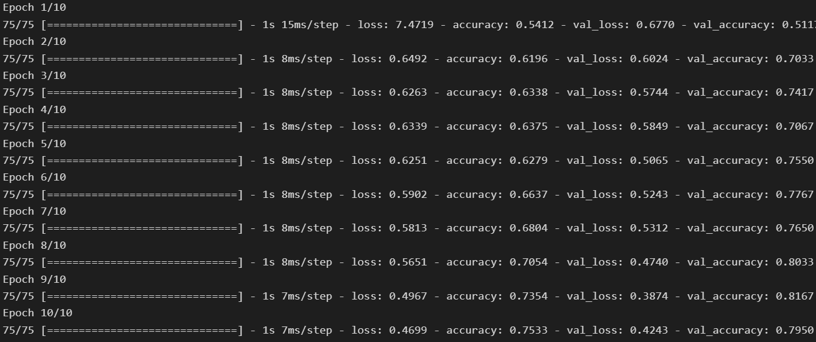
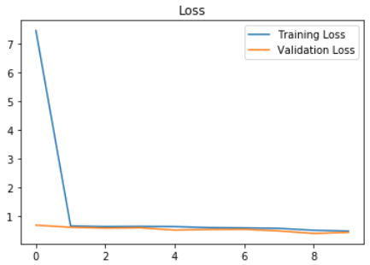
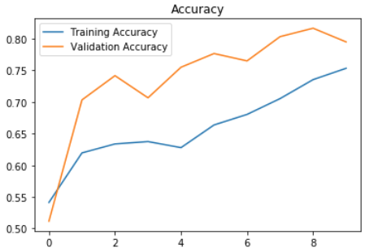
Machine learning analysis
CNN Categorical Cross Entropy Based & SoftMax Function.
Training Set Accuracy: 73.54
Training Set Loss: 0.4967
Validation Set Accuracy: 81.67
Training Set Loss: 0.3874

Slide 15
Machine learning analysis
CNN Binary Cross Entropy Based & Sigmoid Function
Fully Connected NN
+ Sigmoid
Conv + Relu
Pooling 2x2
Conv + Relu
Pooling 2x2
Conv + Relu
Pooling 2x2
Flatten
64x64x3
6x6x32
14x14x32
12x12x32
31x31x32
29x29x32
2304
62x62x32

Slide 16
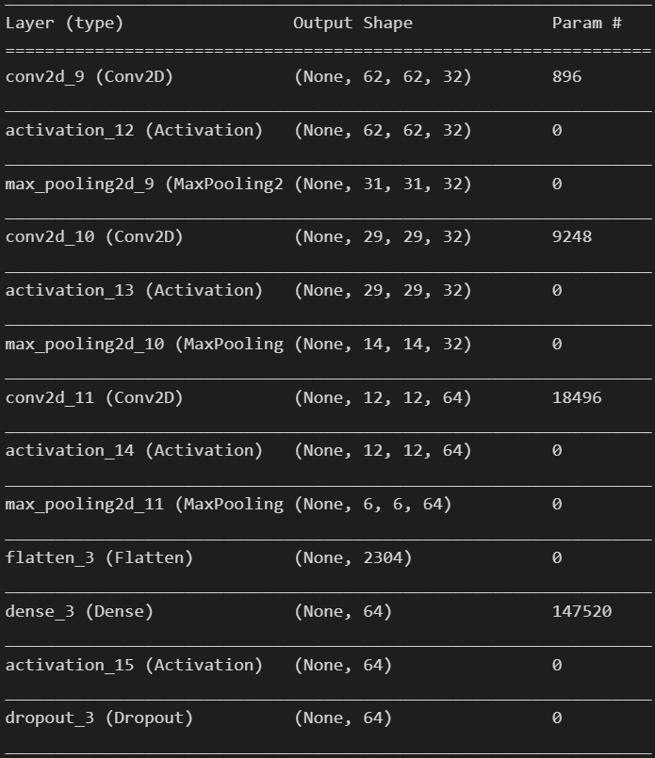
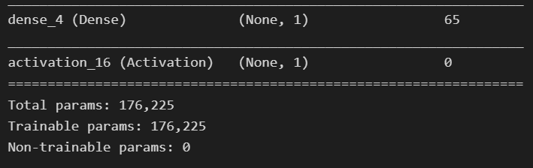
Machine learning analysis
CNN Categorical Cross Entropy Based & SoftMax Function.
Architecture & total number of parameters:
Total Prams: 176.225
Trainable Params: 176.225
Non-trainable: 0

Slide 17
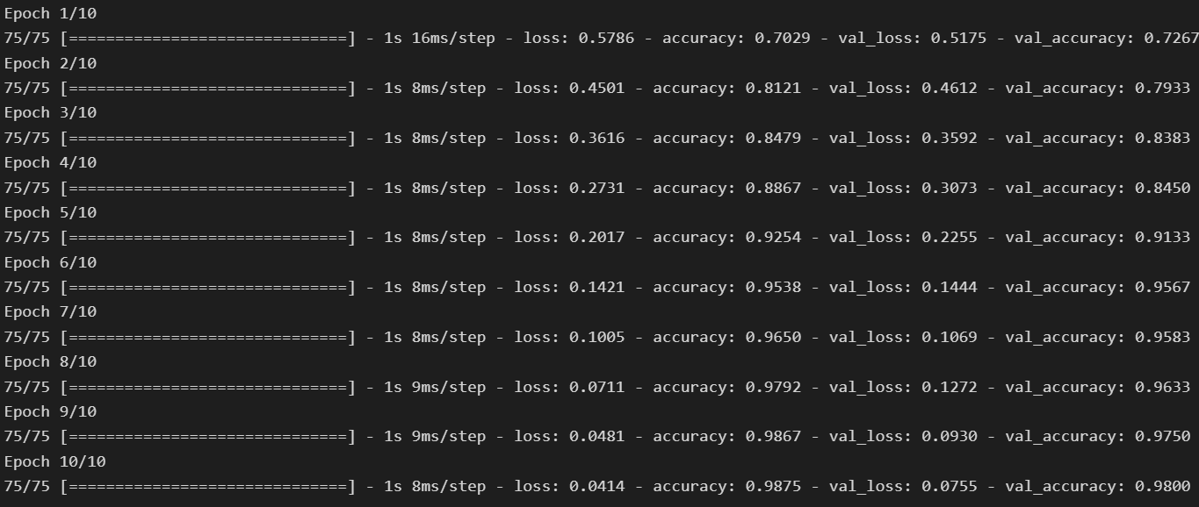
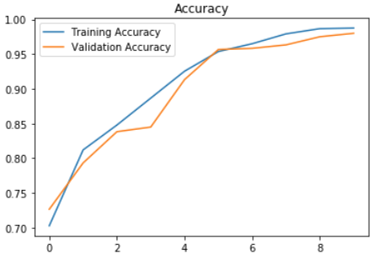
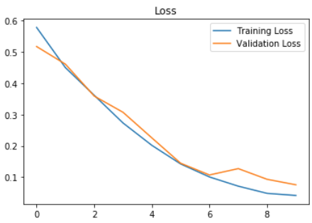
Machine learning analysis
CNN Categorical Cross Entropy Based & SoftMax Function.
Training Set Accuracy: 98.75
Training Set Loss: 0.0414
Validation Set Accuracy: 98
Training Set Loss: 0.0755

Slide 18
Machine learning analysis
Models Comparison
Since we deal with a very sensitive field, tumour diagnosis, we were required to improve our model. We changed the loss function into Binary Cross Entropy and sigmoid function for final prediction layer, which is achieved high accuracy compared to t. The first CNN model, which is based on Categorical Cross Entropy as loss function and SoftMax for final prediction layer, was not that accurate where it is achieved 73% on the training set and 81% on the validation set. While the second achieved better results

Slide 19
Machine learning analysis
Models Comparison
These models have a number of significant flaws, including the inability to identify the type of tumour—whether it is benign or malignant—as well as its incapacity to identify the tumour's location, which is considered an unexplainable model. From this point on, we can enhance our model by including these features in more advanced steps in the future.

Slide 20
Analysis Next Steps
Models Flaws and Strength and further suggestions
We can offer the following other features in addition to identifying malignancies in MRI images:
tumour type classification, including whether it is benign or malignant
Using a sophisticated object detection technique, the tumor's boundaries are found.
putting the model on platforms for smartphones or webapps to make it easier for experts to use.

